Slide 1
Visualizing and Clustering Climate Change Milestone 2
Lei Zhong
Hantian Zhang
Jian Zhang

Slide 2
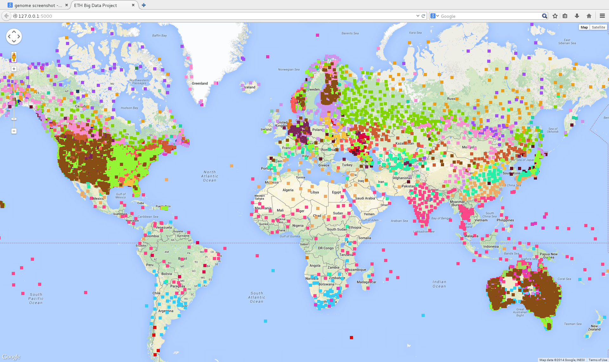
System Overview
Clustering + GoogleMap

Slide 3
Data

Slide 4
Design

Slide 5

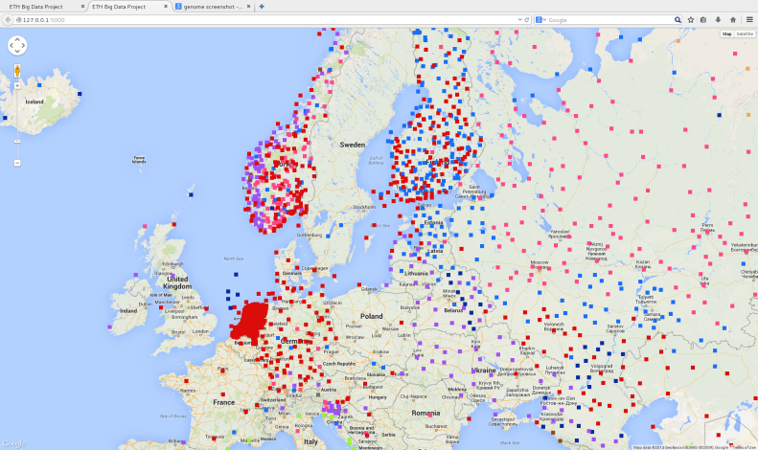
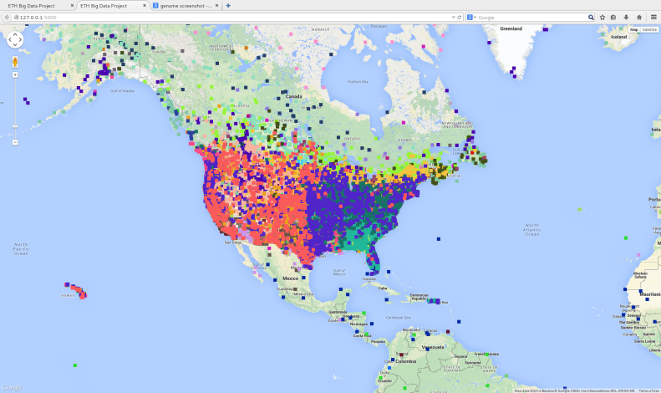
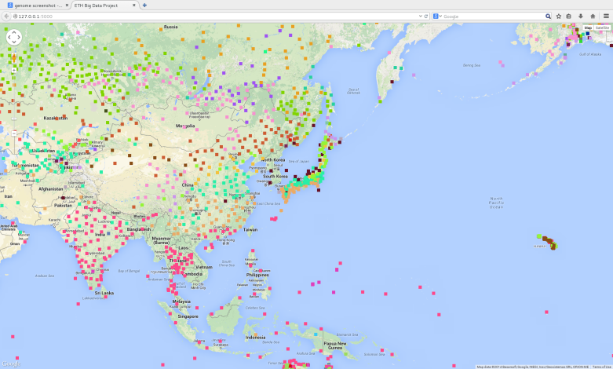
Results
Verification: alignment with prior geology knowledge
Clustering by Latitude, Height above Sea Level, Regional Landform
Well-known Climate Characteristics

Slide 6

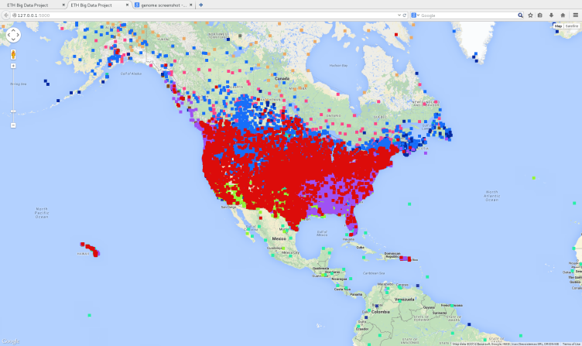
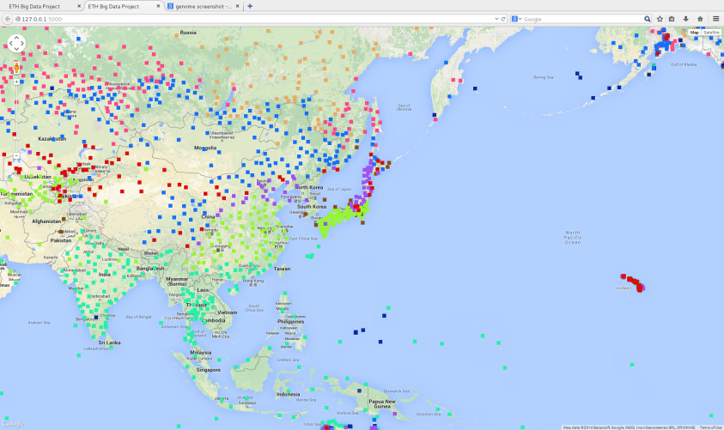

Results
Number of Clusters
Different over different geology characteristics
75 Vs 15 for North America
50 Vs 15 for Asia

Slide 7
Thanks!

